Slide 1
Weekly report: Grid Code Development
Week number: 11
Date: 09/12/2025
Supervisor: Prof. Ing. Saiju
Presented by: Josef Remberger / Vijay Simha Reddy Bogala

Slide 2
List of contents
PowerFactory Results
  PowerFlow
  Short Circuit
  LVRT
  HVRT
Conclusion
Josef Remberger

Slide 3
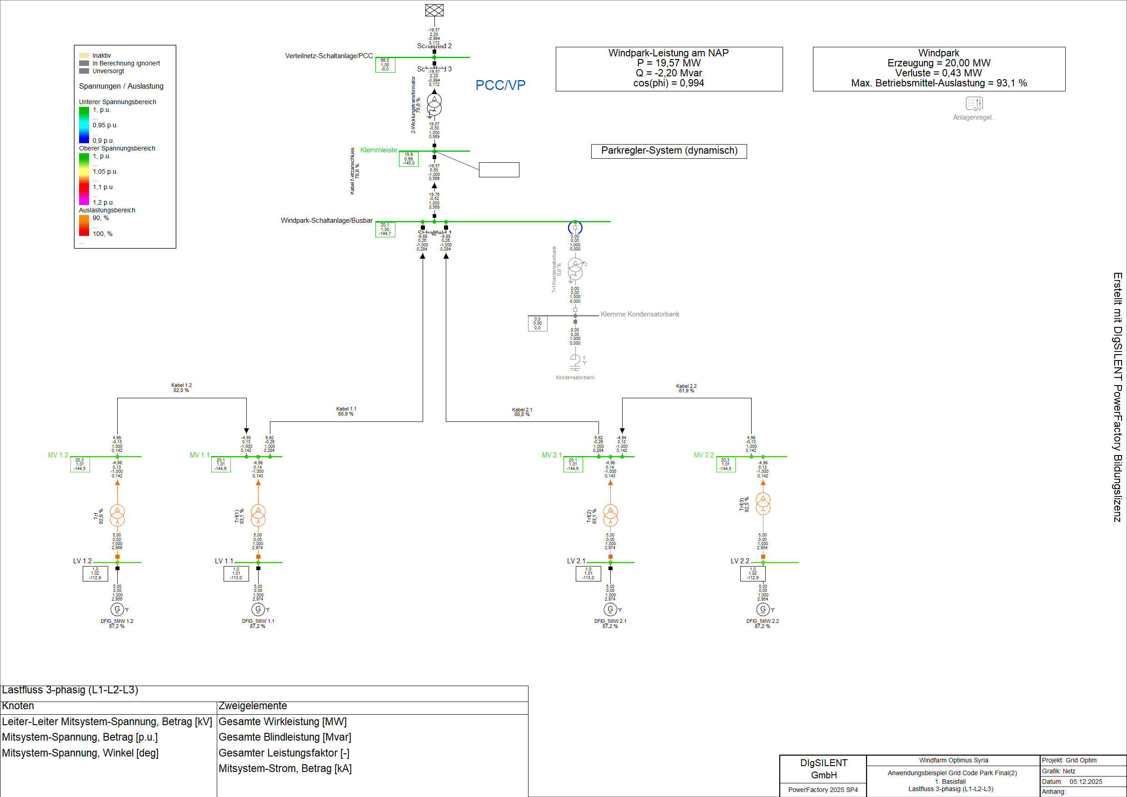
1-i. PowerFlow
Number of turbines: 4
Power at the PCC (Qattinah
Substation): 19,57MW
[1]
Josef Remberger

Slide 4
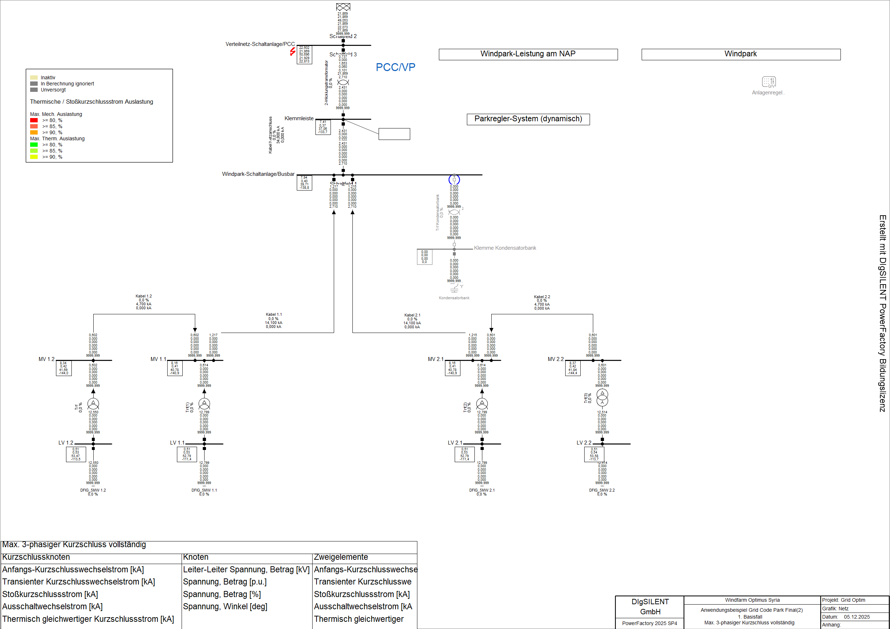
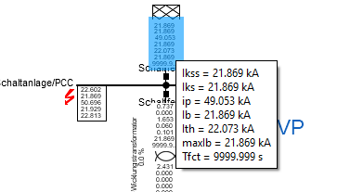
1-ii. Short Circuit
Complete 3-Phase
short circuit at PCC
[1]
Josef Remberger

Slide 5
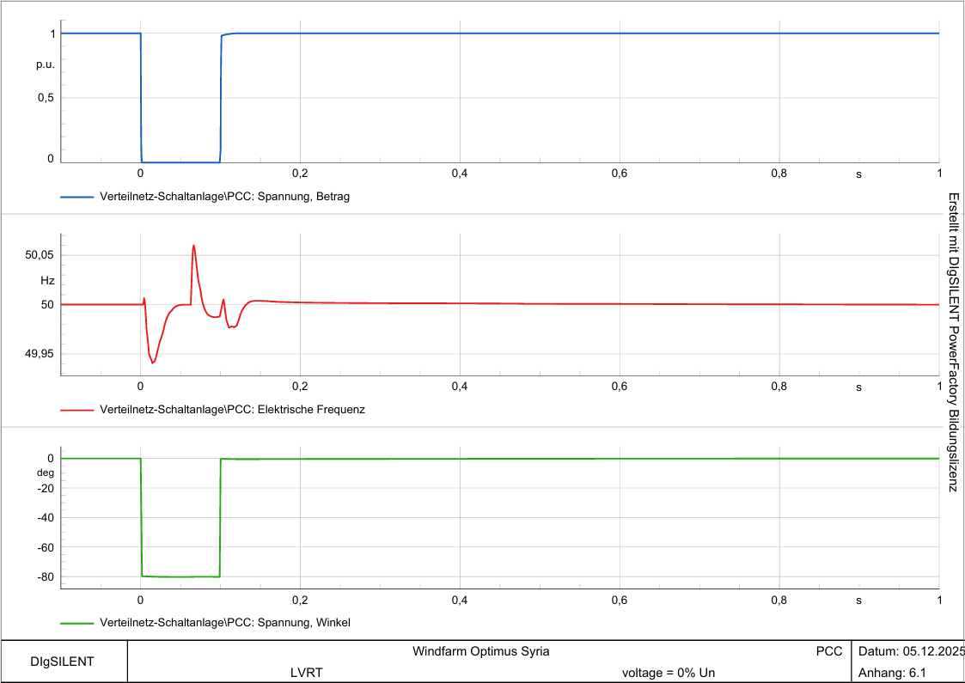
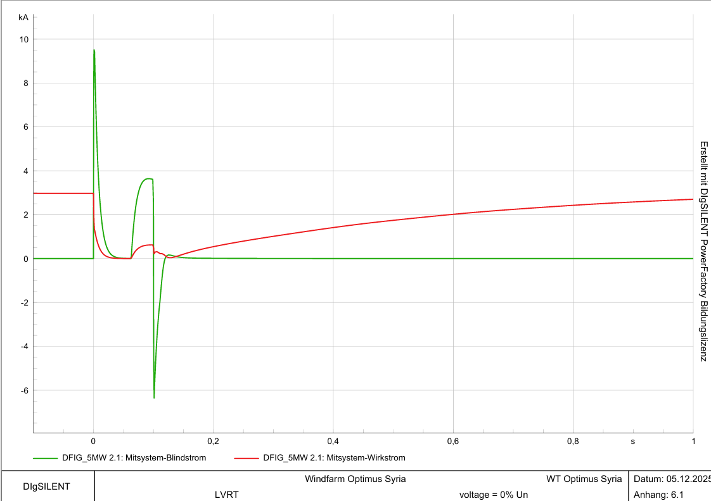
1-iii. LVRT
V_grid = 0 %, time = 100 ms
[1]
Josef Remberger

Slide 6
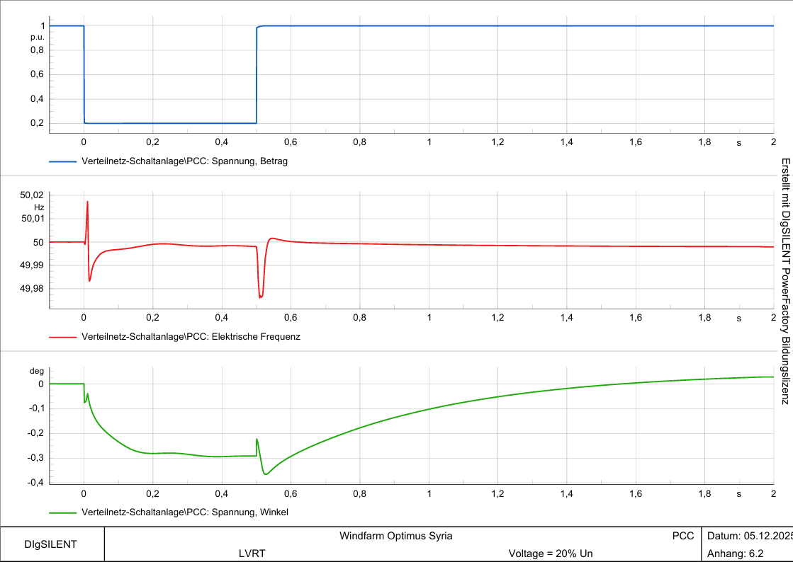
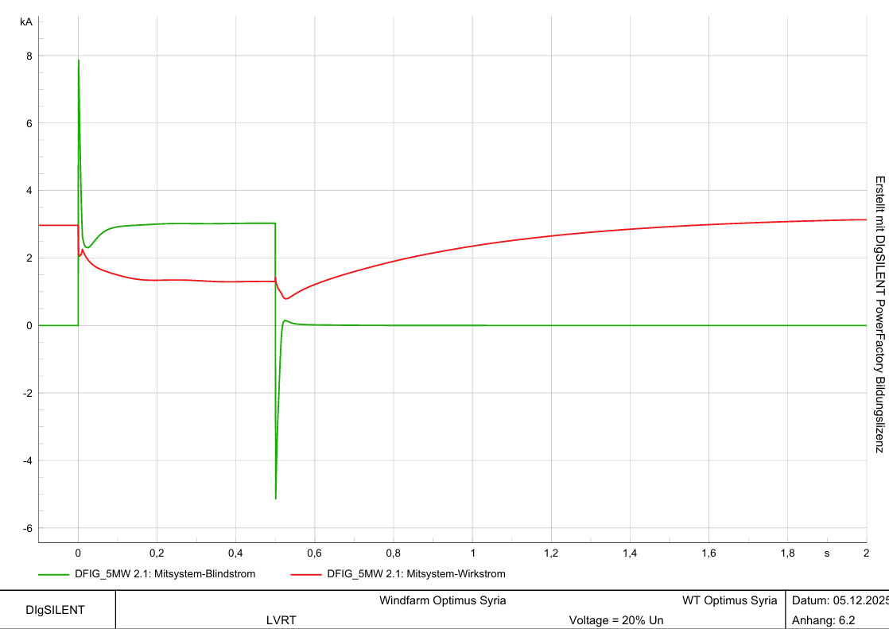
1-iii. LVRT
V_grid = 20 %, time = 500 ms
[1]
Josef Remberger

Slide 7
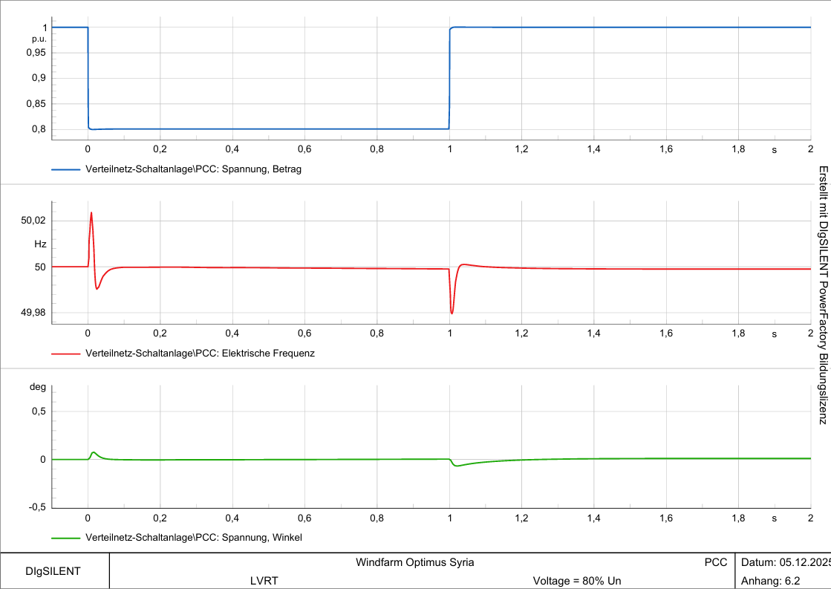
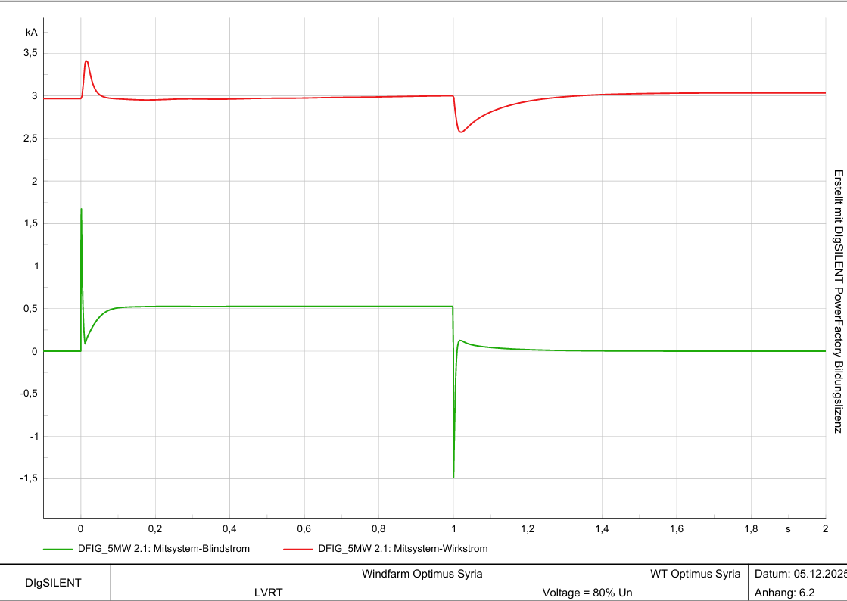
1-iii. LVRT
V_grid = 80 %, time = 1000 ms
[1]
Josef Remberger

Slide 8
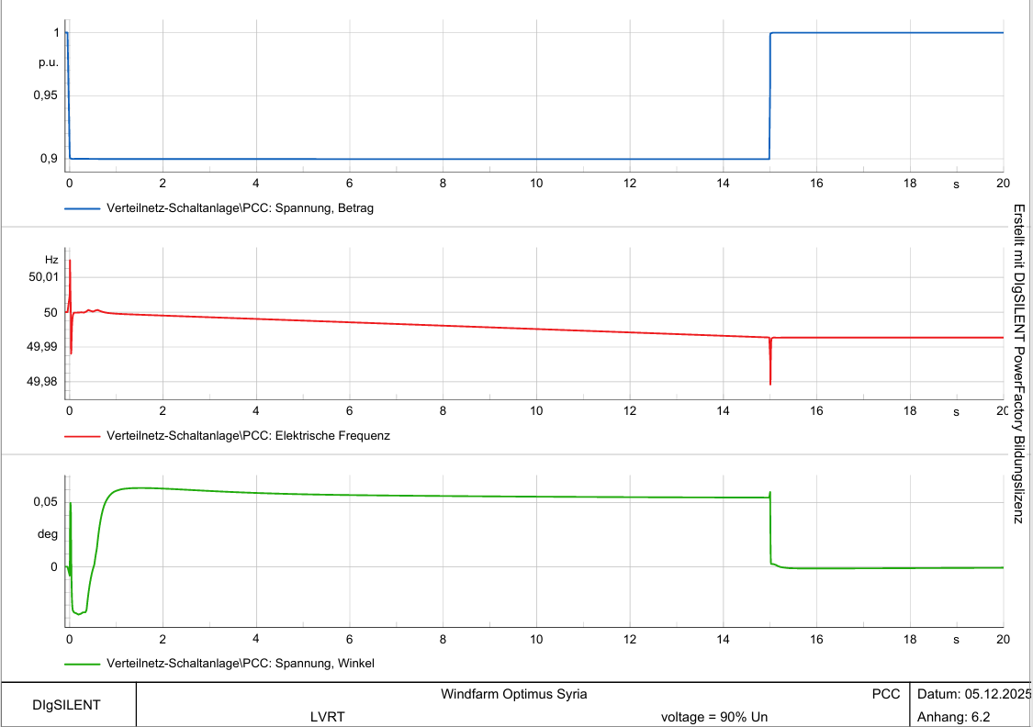
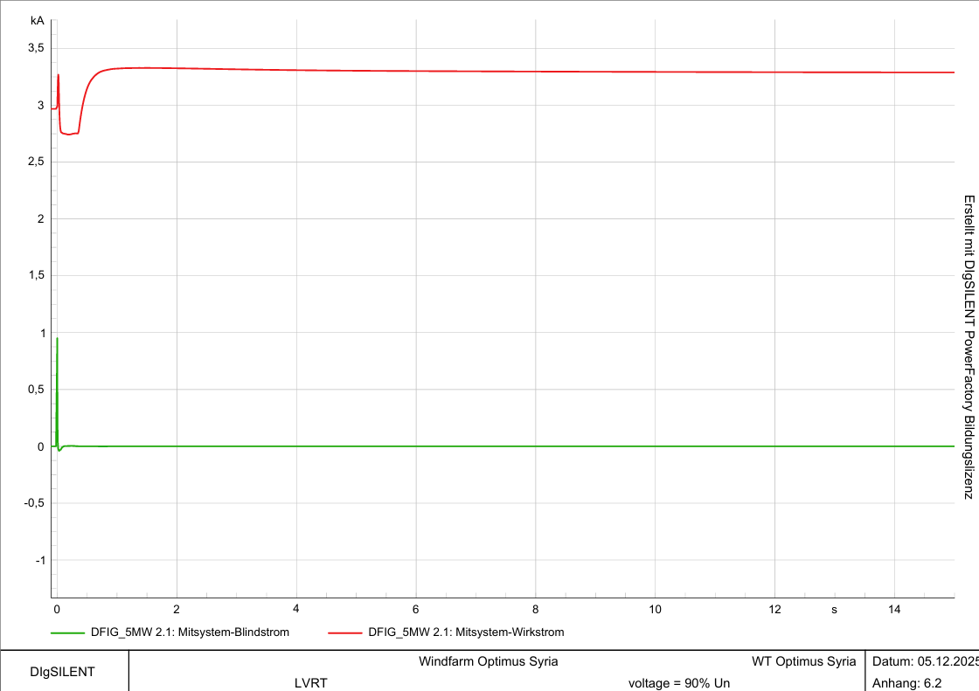
1-iv. LVRT
V_grid = 90 %, time = 15000 ms
[1]
Josef Remberger

Slide 9
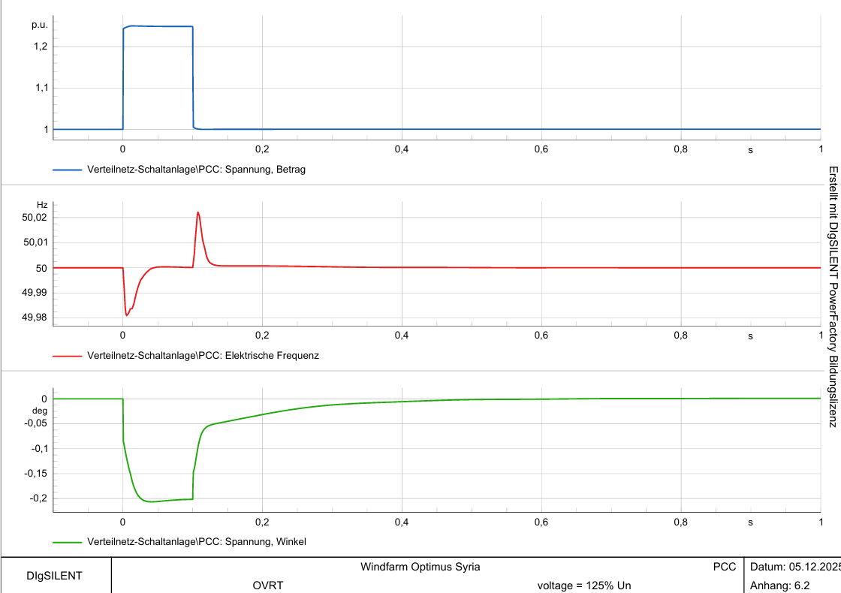
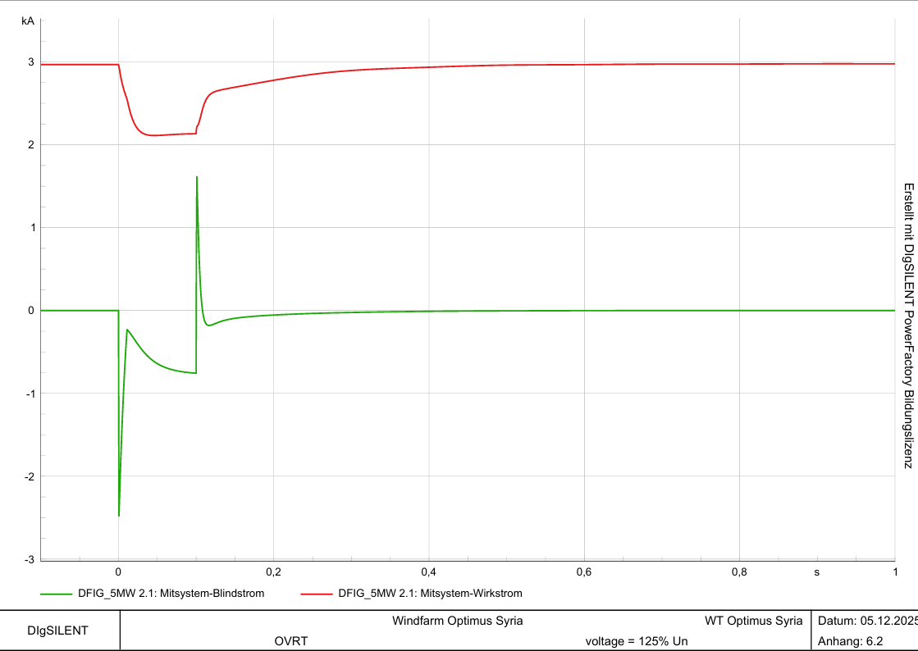
1-iv. HVRT
V_grid = 125 %, time = 100 ms
[1]
Josef Remberger

Slide 10
1-iv. HVRT
V_grid = 120 %, time = 5000 ms
-> turbines are disconnected due to inadequate protection settings in the turbine controller
[1]
Josef Remberger

Slide 11
2. Conclusion
Grid Code compliance for our turbine with the current protection devices excluded the 120% HVRT✓
  -> Adjustments must be made to the controller settings in PowerFactory
Josef Remberger

Slide 12
Bibliography – Grid Code Development
[1] Created with PowerFactory / DigSilent

